Slide 1

Liability – Fronted Solutions
SWERMA
Erik Blom
May 2026

Slide 2

Agenda
Traditional approach to structure a Liability program
Liability exposure increase
Drivers of US social inflation
Liability exposure increase outside US
Liability result - negative trend
Liability – hardening market
Program change in hardening market
Program fronting structure
Primary Fronting
Full Tower Fronting
Several Fronters
Captive Fronting
Shared Sublimits
Key Takeaways

Slide 3

Traditional approach to structure a Liability program
Large limits in XoL structure supported by Treaty
Program Limit USD 150,000,000 | Reinsurance Treaty
2nd Excess Layer Insurer 3- USD 50,000,000 in excess of USD 100,000,000 | Treaty Reinsurer 3
 | Net retention
1st Excess Layer Insurer 2- USD 50,000,000 in excess of USD 50,000,000 | Treaty Reinsurer 2
 | Net retention
Primary Layer Insurer 1- Primary USD 50,000,000 | Treaty Reinsurer 1
 | Net retention

Slide 4

Liability exposure increase
US Social inflation
1970s–1980s: The concept of social inflation emerged, driven by evolving legal theories, increased litigation, and changing societal attitudes toward liability and compensation.
2010s: Social inflation saw a resurgence, with court awards and settlements rising faster than economic growth, especially in liability lines.
2018–2023: Defense costs for large corporations increased by about 10% annually, fueled by a sharp rise in nuclear verdicts (jury awards over $10 million).
2013–2023: Liability claims increased by as much as 57%, reflecting both higher frequency and severity of claims.
2020–present: Social inflation continues to outpace economic inflation, driven by factors such as litigation funding, greater jury sympathy for plaintiffs, and evolving social norms.
Increased exposure over time, mainly driven by US

Slide 5





Drivers of US social inflation
Reptile theory tactics are legal strategies used by plaintiff attorneys in liability cases. They appeal to jurors’ primal instincts - fear and self-preservation - by arguing that the defendant’s actions threaten community safety. The goal is to encourage jurors to award large damages to “protect themselves and others.”
Anchor theory is a legal tactic where attorneys suggest a specific, often high, dollar amount for damages to the jury. This “anchor” influences jurors’ thinking, making them more likely to award a sum close to that figure - even if it’s much higher than what might be reasonable.
Class action lawsuits are legal cases where one or several people sue on behalf of a larger group with similar claims against the same defendant.
Litigation funding is when a third party (not the plaintiff or defendant) provides money to cover legal costs in exchange for a share of any settlement or award.
Legal advertising Reptile theory tactics Anchor theory
Class action lawsuits Litigation funding

Slide 6

Liability exposure increase outside US
Social inflation and increased exposure outside US
Social inflation is primarily a US phenomenon, but similar trends are emerging in other countries.
UK and Australia have seen double-digit growth in liability claims, outpacing economic inflation.
In the UK, social inflation contributed more than 10% to liability claims growth in 2022; Australia and Canada saw contributions around 7%.
New EU legislation is expected to increase liability exposure in Europe going forward.
Litigation funding is becoming more common internationally, supporting larger and more frequent claims, and is starting to influence the EU market.

Slide 7

Liability result - negative trend
Exposure clearly increased during soft market conditions
The global liability insurance market experienced a soft market for approximately 15 years before the hardening began around 2018–2019.
This soft market period started in the early 2000s and was characterized by:
- Low premiums
- Broad coverage terms
- High capacity from insurers
- Competitive underwriting
The prolonged soft market ended as claims costs, litigation, and risk exposures increased, leading to the hardening phase

Slide 8
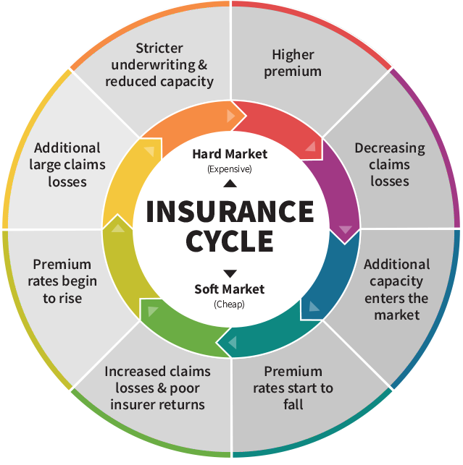
Liability – hardening market
Profitability challenges on global liability market
The hardening market characterized by:
Increased premium rates
Reduction of coverage
Treaty reinsurance rate increases
Vast reduction of capacity
Re-underwriting
Current market conditions:
Less exposed accounts, not least Mid-Market, is to be seen as soft.
Well managed global US exposed accounts is more stable but still under pressure from US inflation.
Many accounts are one large loss away from facing major adjustments to both rate and capacity.

Slide 9
Program change in hardening market
Local Policies
  Rates going up in general but drastically on high exposed accounts
  Reinsurance rates going up which drives rates over portfolio in general
  Less capacity in the market
  Need to reduce volatility to protect result and treaty which have a long-term impact
  Primary layers being reduced same time as exposure drastically increasing - a large total limit from many carriers might be a cold comfort if primary is eroded as excess layers not dropping down on local program policies
Same program limit ensuring risk transfer of catastrophic type of losses you don’t expect on annual basis
Primary substantially reduced – “normal” losses such as personal injury and excess auto can erode primary
If primary eroded the local cover in the program will become a challenge from many aspects:
  Claims perspective – no local claims handling
  Compliance – cannot operate on FinC basis
  No valid certificates – tenant liability issues, not able to enter a customer site, cannot sell products etc.
  Contractual breaches if local cover not aligned with contractual obligations
  Administrational challenge for the insured as primary insurer no longer involved

Slide 10
Program fronting structure
Primary Fronting
  Efficient way to increase limit to a sufficient level
  Good way to build a long-term stable and strategic relation with more than one primary insurer
  Can be several carriers supporting primary with USD 5,000,000 or more

Slide 11
Program fronting structure
Primary Fronting
  Fronting primary
  Include 1st excess in primary
  If 1st excess is low priced this can drive premium to some extent but in this market might be able to make some savings on the higher layers to invest in a more stable and stronger primary

Slide 12
Program fronting structure
Full Tower Fronting
The insured benefits from having a single contracting party, simplifying administration.
If a large loss occurs, the insured only needs to communicate with one party, streamlining the claims process.
It is possible to create a flexible reinsurance panel that includes both strategically important partners and more transactional capacity providers.
The structure can present challenges, particularly when the fronting insurer is required to accept all reinsurers on the panel.

Slide 13
Program fronting structure
Several Fronters
In large programs with many insurers, the insured benefits from having a small number of contracting parties, which simplifies administration.
The insured is able to further strengthen the relationship with a small number of strategically important insurers.
This structure can make the process easier for the fronting insurer when accepting all reinsurers from a credit risk exposure perspective.
If a large loss occurs, the insured only needs to be in contact with the partnering fronting insurer, rather than a large number of insurers on the excess layers (depending on structure).

Slide 14
Program fronting structure
Captive Fronting
If the insured uses its own captive, the solution becomes even more flexible. The traditional captive fronting structure remains applicable in such arrangements
In cases where the captive wants further control, a 100% captive fronting arrangement may be used as an alternative solution. This is often combined with the appointment of specific loss adjusters
Some fronting insurers may require partial risk retention (for example, 10% risk transfer is common), while others are willing to accept risk transfer on the retrocession and may agree to 100% ceding

Slide 15
Program fronting structure
Shared Sublimits
  High exposed sublimits like recall, D&R, PFL and PI – can be difficult to obtain sufficient cover by one insurer
The carriers dividing the sublimited exposure 50/50, can be an advantage:
  Ability to obtain sufficient cover
  Attract further carriers and increase competition
  If a total loss occurs, it would not be a large loss for the carriers, which likely reduces volatility
  Might have a positive effect on the premium, as some of the more catastrophic-type exposures are removed
The purple program is handled by one insurer, taking 100% of the sublimits.
The purple/blue primary is fully fronted by blue, with 50% reinsurance on a quota share basis from purple.
From the insured’s perspective, both programs provide the same cover and service, as all contact is with blue.

Slide 16

Key takeaways
Insurer perspective
Profitability: stable structure will reduce volatility and protect the treaty insurers (avoiding negative result and general rate increases)
Active risk transfer: be an active part of the risk transfer strategy and ensure the provision of providing sufficient cover
Broaden appetite: expand the appetite for high-hazard risk classes and US exposures
Customer focus: opportunity to work more closely with customers at the primary level, even if not appointed as the lead fronting insurer
Insured perspective
Primary limits: primary limits can be easily eroded by single large losses (e.g., personal injury, product liability, excess auto claims)
Capacity: need for sufficient sublimited types of capacity
Stable structure: preference for a long-term, stable structure where single large losses do not have a significant impact, as risks are shared among several primary insurers
Strategic partnerships: great value in having strategic partners on the primary layer
Broker perspective
Risk transfer alternatives: ability to provide a much wider range of risk transfer alternatives and tools to optimize the customer’s structure and needs
General observations
Early appointment: appoint the fronting insurer early to avoid excessive blocked capacity during the process
Planning: start early and establish a clear plan in collaboration with all parties involved
Transparency: maintain transparent collaboration throughout the process - everyone should work together to find the best possible long-term solution with a clear focus on total cost of risk transfer

Slide 17
Legal information

